Slide 1

S. S. Education Trust’s CET Code: E-175 (UG)/T-942 (PG) S. G. BALEKUNDRI INSTITUTE OF TECHNOLOGY Shivabasavanagar, Belagavi- 590 010, Karnataka- India Office: 0831-2407172, 2554559 Fax: 0831-2407152Website: www.sgbit.edu.in
COVID-19 SAFETY ENTRY/EXIT WITH ATTENDANCE SYSTEM
Project Guide:
Prof. Shaheen Mujawar
Team:
Sayojya Patil - 2BU19CS023
Sudarshan Hundre - 2BU19CS047
Umar Jamadar - 2BU19CS054
Vinayak Kamble - 2BU19CS055
Vishant Patil - 2BU19CS056

Slide 2

Contents
ABSTRACT
INTRODUCTION
EXISTING SYSTEM
PROPOSED SYSTEM
REQUIREMENTS
PROJECT STRUCTURE
WHAT IS FIREBASE?
PACKAGES USED
MODULES USED
APPLICATION DESIGN
CONCLUSION AND FUTURE ENHANCEMENT

Slide 3
Abstract
This system is acquainted with upgrade wellbeing and security at a given spot in this dubious conditions of coronavirus infection.
It diminishes man work and subsequently lessens the danger of the individual getting tainted from the coronavirus infection.
This system is efficient .
It very well may be introduced at any ideal spot
It keeps a check of individuals entering the premises and it stores the details in the database created.

Slide 4
Introduction
In this uncertain conditions because of the wide spread of Coronavirus infection, it has gotten compulsory to continue cleaning hands and checking temperature while entering shops, eateries, school/college premises, workplaces, etc to forestall the spread of the infection. Due to Incessant temperature checking and purifying necessities work, the work incharge of the checking under go high danger as he/she interacts with numerous individuals on regular routine.
The general venture degree is to guarantee wellbeing of people in this unsure conditions and to improve security at a spot. This system will be made utilizing joined information on hardware and software engineering. By introducing this system, an association can monitor sick individuals entering the premises which will be helpful to forestall spread of the coronavirus infection.

Slide 5
existing system
The old arrangement of Coronavirus security checking needs a man on the job continuously to check temperature of people entering the premises and for allotting sanitizer. This framework isn't ok for both the man on the job and the individual entering the premises as various people interact with the man incharge on an every day schedule. This current framework requires standard wellbeing types of gear like PPE kits and there is a need to supplant this PPE units ideal and arrange them securely.

Slide 6
Proposed system
This undertaking is configuration to mechanize the cycle of temperature checking and sanitiser apportioning at the section of a premises. This framework will be introduced at the passage of the premises where when an individual ready to enter the premises should filter his/her id card and afterward his/her constant temperature with time stamp and a image will be put away in the Realtime Database created. And on the off chance that his/her temperature is right as indicated by the Covid-19 standards the entryways of the premises will naturally open for that person. The sanitiser administering machine will apportion sanitiser consequently at whatever point the individual's hand is under the distributor and the individual need not touch the container.
The admin monitoring the attendance of individuals can access the realtime database with the application created from anywhere.

Slide 7



Requirements
Knowledge of Python, Java and Android Studio
Raspberry Pi 3 B+
Raspberry Pi cam
MLX90614 Infrared Temperature Sensor
RFID Module
Ultrasonic Sensor (2 nos.)
IR Sensor
DC Motor
DC Pump
Jumper Wires
PCB’s
Buzzer
OLED Screen
12V Adaptor (2 nos.)

Slide 8

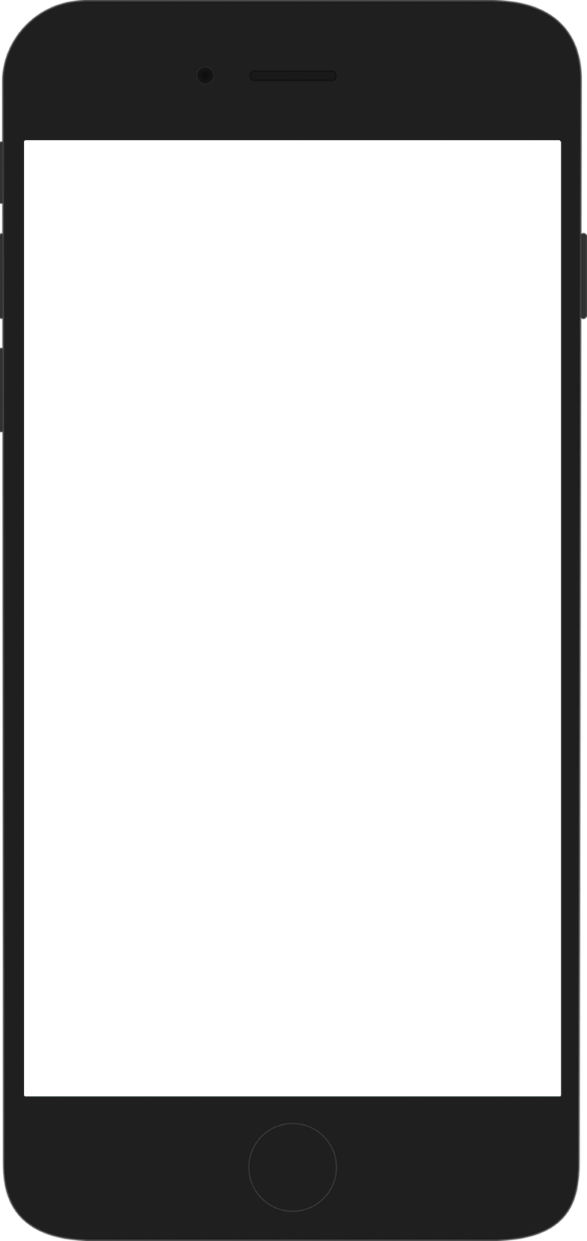
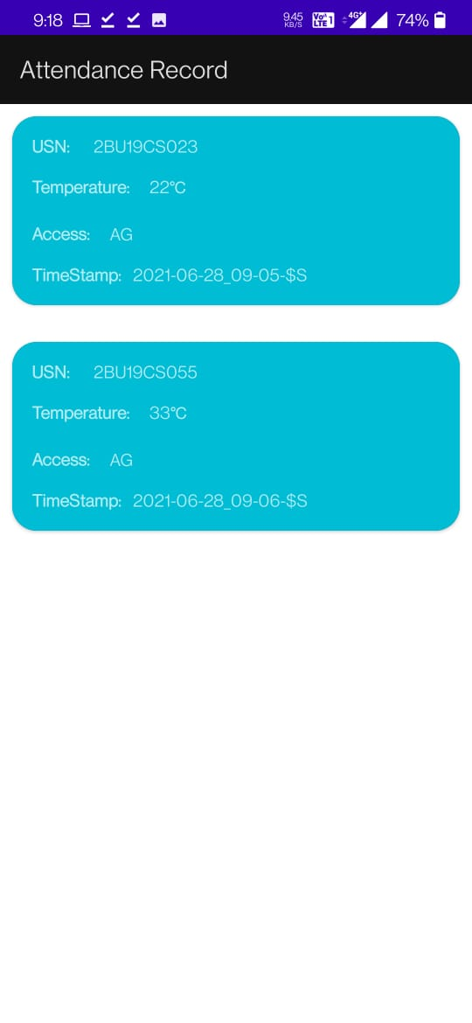

Project Structure
Raspberry Pi 3B+
Display
Door
RFID Scanner
MLX90614
Ultrasonic Sensor
Ultrasonic Sensor
Sanitiser apportioning machine
Database
Application

Slide 9

WHAT IS FIREBASE?
Firebase is a toolset to “build, improve, and grow your app”, and the tools it gives you cover a large portion of the services that developers would normally have to build themselves, but don’t really want to build, because they’d rather be focusing on the app experience itself. This includes things like analytics, authentication, databases, configuration, file storage, push messaging, and the list goes on. The services are hosted in the cloud, and scale with little to no effort on the part of the developer.

Slide 10

Packages Used
OpenCV Package for Python:
OpenCV is the huge open-source library for the computer vision, machine learning, and image processing and now it plays a major role in real-time operation which is very important in today's systems. By using it, one can process images and videos to identify objects, faces, or even handwriting of a human.
Pyrebase:
Pyrebase is a Python interface to Firebase's REST API. In layman's terms, it allows you to use Python to manipulate your Firebase database
The Pyrebase module provides a simple interface for performing each of the CRUD functions. There are two methods available for creating a new data entity in your database, push() and set(). These methods can be used in conjunction with the child() method, which builds paths to objects in the database.

Slide 11
MODULES Used
time Module:
The Python time module provides many ways of representing time in code, such as objects, numbers, and strings. It also provides functionality other than representing time, like waiting during code execution and measuring the efficiency of your code.
OS Module:
The OS module in Python provides functions for interacting with the operating system. OS comes under Python's standard utility modules. This module provides a portable way of using operating system dependent functionality. The *os* and *os. path* modules include many functions to interact with the file system.

Slide 12
Application Design
The admin monitoring the attendance of individuals can access the realtime database with the application created from any part of the world.
All Components overview
Data
RecyclerView scrolling list for list items—RecyclerView
Layout for one item of data—XML file
Layout manager handles the organization of UI components in a view—Recyclerview.LayoutManager
Adapter connects data to the RecyclerView—RecyclerView.Adapter
View holder has view information for displaying one item—RecyclerView.ViewHolder

Slide 13
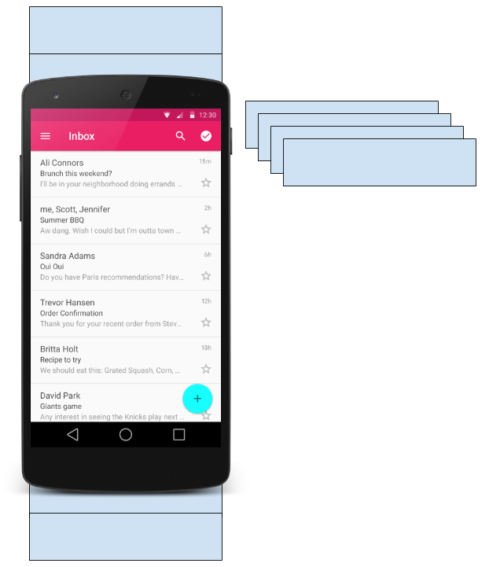
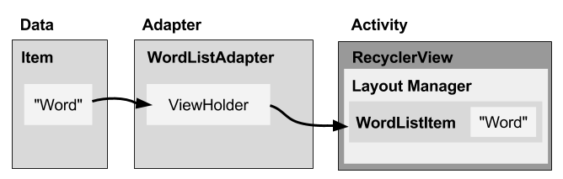
Application Design
What is a Recycler View?
Scrollable container for large data sets
Efficient
uses and reuses limited number of views
Updates changing data fast
RecyclerView
How components fit together overview

Slide 14
Application Design
What is a layout manager?
All view groups have layout managers
Positions item views inside a RecyclerView.
Reuses item views that are no longer visible to the user
Built-in layout managers include LinearLayoutManager, GridLayoutManager, and StaggeredGridLayoutManager
For RecyclerView, extend RecyclerView.LayoutManager
What is an adapter?
Helps incompatible interfaces work together, for example, takes data from a database Cursor and puts them as strings into a view
Intermediary between data and view
Manages creating, updating, adding, deleting item views as the underlying data changes
RecyclerView.Adapter

Slide 15
Application Design
What is a view holder?
Used by the adapter to prepare one view with data for one list item
Layout specified in an XML resource file
Can have clickable elements
Is placed by the layout manager
RecyclerView.ViewHolder

Slide 16
conclusion and future enhancement
Since we are using the OpenCV package this system can further be updated with face detection and the user need not scan his/her ID cards every time they enter the premises .
So the ultimate aim of this project is to maintain wellbeing of individuals and security. We would like to conclude by saying that every institution should opt for this framework as it requires very less manpower hence reducing the risk to their lives.

